Slide 1
Behavioral Economics And Public Policy: Introduction and Normative Foundations
Econ 178: Behavioral Economics
Marcelo Clerici-Arias

Slide 2
Agenda
Introduction
Normative assumptions
Normative vs. positive economics
Foundations of welfare economics
Accommodating behavioral phenomena
Empirically identifying mistakes

Slide 3
Introduction

Slide 4
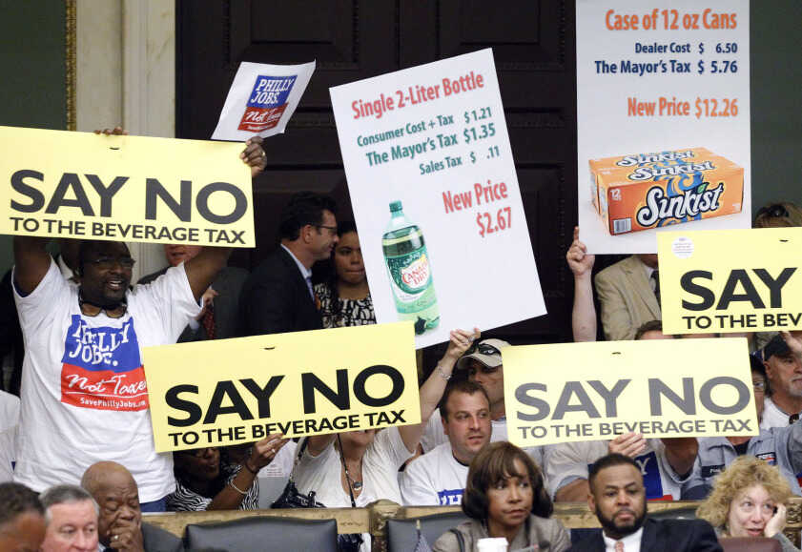
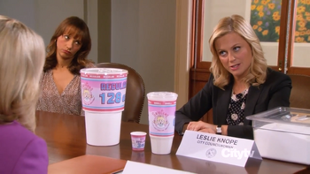
Should we tax sugary beverages?
Implemented in Boston, Philadelphia, SF, Berkeley, Oakland, Boulder, Seattle…
Tried other places but unpopular.
Notes:
WHO Report: https://apps.who.int/iris/bitstream/handle/10665/260253/WHO-NMH-PND-16.5Rev.1-eng.pdf
Philadelphia Protest: https://www.npr.org/2011/07/30/138598864/in-tough-times-philadelphia-bucks-the-trend
Parks and Rec: https://parksandrecreation.fandom.com/wiki/Soda_Tax
List of cities with tax: https://www.urban.org/policy-centers/cross-center-initiatives/state-and-local-finance-initiative/state-and-local-backgrounders/soda-taxes
Note that the parks and rec image is FICTIONAL. In that episode, Leslie Knope (a city councilwoman) tries to get a soda tax passed, but faces opposition from industry leaders and citizens.

Slide 5
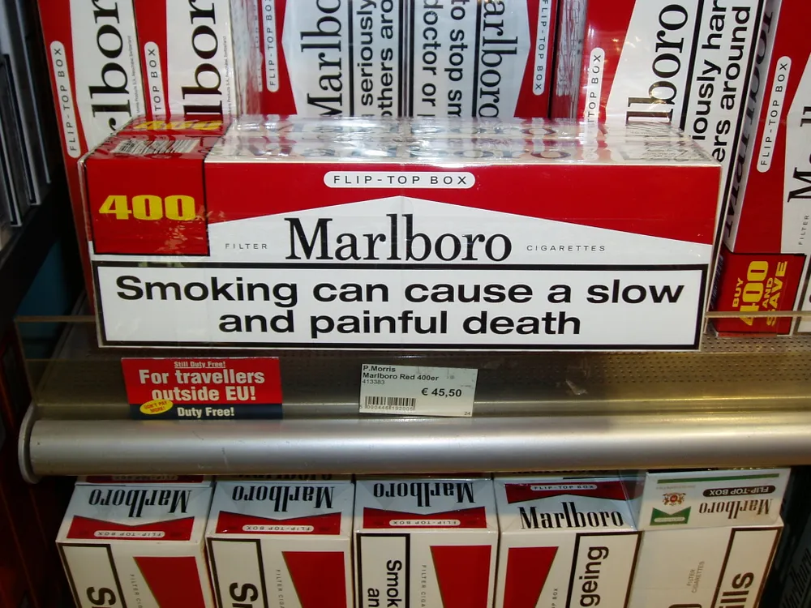
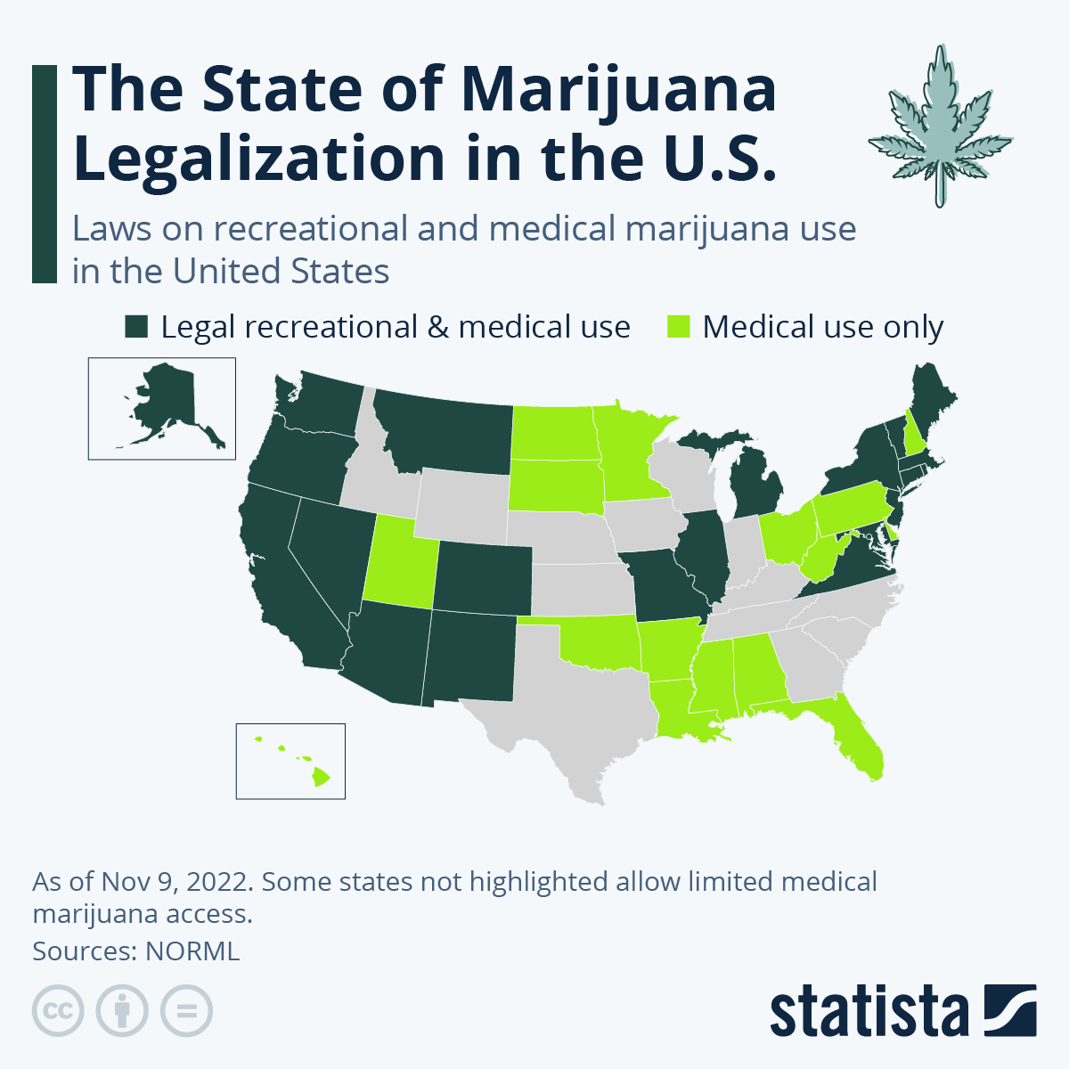
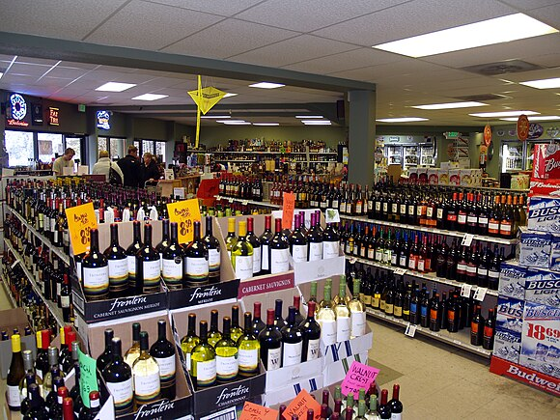
How should we regulate addictive substances?
Taxes?
State + federal revenue from alcohol taxes was about $18.1 billion in 2020
Bans?
Warning labels?
Do nothing?
Notes:
Malboro: https://www.smithsonianmag.com/smart-news/cigarette-warning-labels-more-graphic-180961721/
Liquor Store: https://en.wikipedia.org/wiki/Alcoholic_beverage
Marijuana: https://www.statista.com/chart/6681/the-states-where-its-legal-to-smoke-marijuana/
18.1 billion from tax policy center, tables here https://www.taxpolicycenter.org/statistics/types-federal-excise-taxes and here https://www.taxpolicycenter.org/statistics/state-and-local-alcohol-tax-revenue

Slide 6
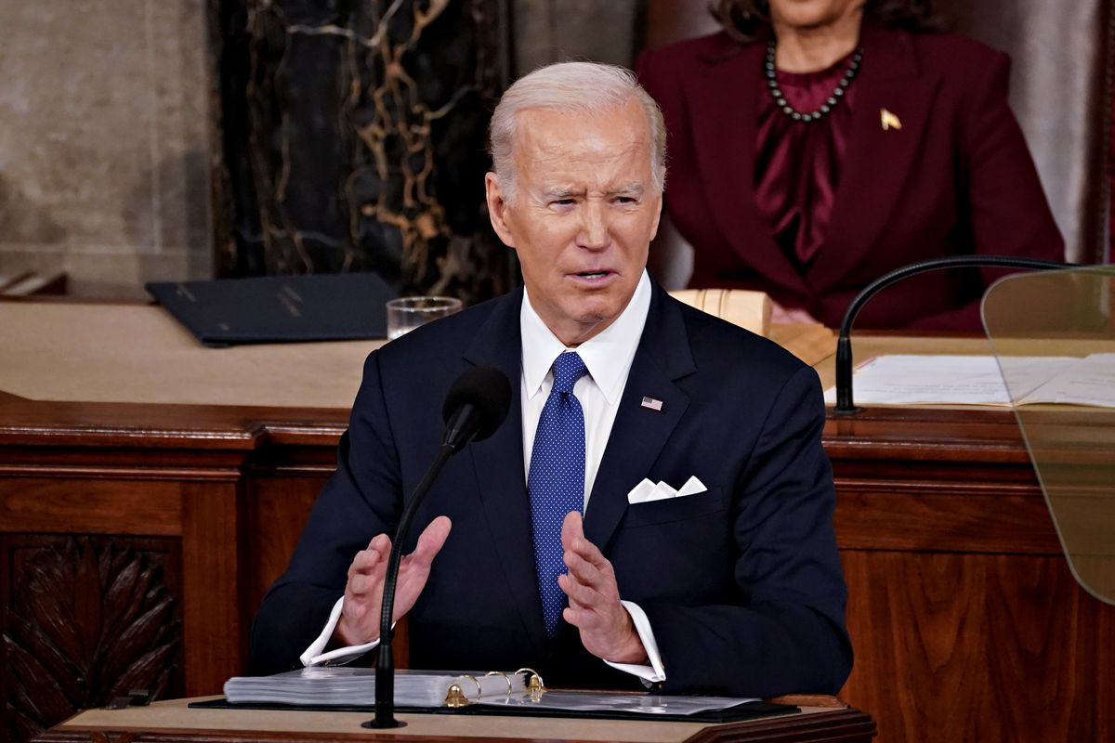
Should we ban “junk fees?”
My administration is also taking on junk fees, those hidden surcharges too many companies use to make you pay more. For example, we’re making airlines show you the full ticket price upfront, refund your money if your flight is cancelled or delayed... We’re going to ban surprise resort fees that hotels charge on your bill. Those fees can cost you up to $90 a night at hotels that aren’t even resorts.
– Joe Biden, 2023 State of the Union
Notes:
https://www.consumerfinance.gov/about-us/newsroom/cfpb-issues-guidance-to-help-banks-avoid-charging-illegal-junk-fees-on-deposit-accounts/
https://www.vox.com/policy-and-politics/2023/2/7/23584680/biden-state-of-union-2023
https://www.whitehouse.gov/state-of-the-union-2023/

Slide 7
Let’s use behavioral econ tools to answer these Qs!
Discuss philosophical assumptions
When and why are interventions to correct behavioral errors warranted?
Study corrective taxation as a canonical regulation
Understand parameters that determine the optimal tax
Compute an optimal tax given assumptions about key parameters
Extend analysis to behavioral interventions
Compare effects of “nudges” to effects of taxes
Discuss choices between traditional and non-traditional interventions
Equilibrium effects of interventions
Transparency in competitive markets
Spillovers to other markets
Political considerations

Slide 8
Normative Foundations

Slide 9
Positive and normative economics
Keynes (1890) definition
Positive economics concerns “what is”
Normative economics concerns “what ought to be”
Examples
Positive statement: If we tax cigarettes at $0.25/pack, cigarette consumption will fall by 10%.
Normative statement: We should tax cigarettes at $0.25/pack.
Warning: invocation of “should” $↔$ philosophical assumptions!
But without doing so, we cannot make policy recommendations
Notes:
This Keynes was John Maynard’s grandfather!
Note with the examples that the first statement doesn’t necessarily imply the second. You can disagree with me about what we should do but still find my positive findings valuable.

Slide 10
Foundations of standard welfare economics
Standard premises (Bernheim and Taubinsky, 2018)
We are all the best judges of our own well-being
Our judgements are governed by coherent, stable preferences
Our choices mirror our preferences: we choose the option we most prefer out of the available alternatives
(1): deference to individual judgment
Liberal justification: my views about my life are paramount because it is, after all, my life! (self-determination)
Cartesian justification: Only I have access to my own experiences
Nonpaternalistic
(2): primarily a technical assumption (implies WARP)
(3): revealed preference assumption
Allows us to replace “Would x or y be better for Matt?” with “Would Matt choose x or y?”
Revealed preference + positive economics $=$ welfare economics
Underpins concepts like consumer surplus, Pareto efficiency, etc.
Notes:
Alternatives to (1): Welfare hedonism (e.g, pleasure and pain as in Bentham) or objective list accounts (e.g, Aristotle on virtue or many religious worldviews)
Can animate bullet points as they arise.
“Nonpaternalistic” <-> “Deference to individual judgment means that welfare economics can accommodate a great degree of pluralism. It could be that one person’s dream is to be a high-powered lawyer, while another wants a life with plenty of leisure time spent with family and friends, and a third wants to live an ascetic life while seeking spiritual enlightenment. The key thing is that economists do not impose any of these particular notions of “the good life” on anyone. Instead, we say that people should be allowed to decide for themselves. That’s what it means to be nonpaternalistic.”
Pause here for questions or comments

Slide 11
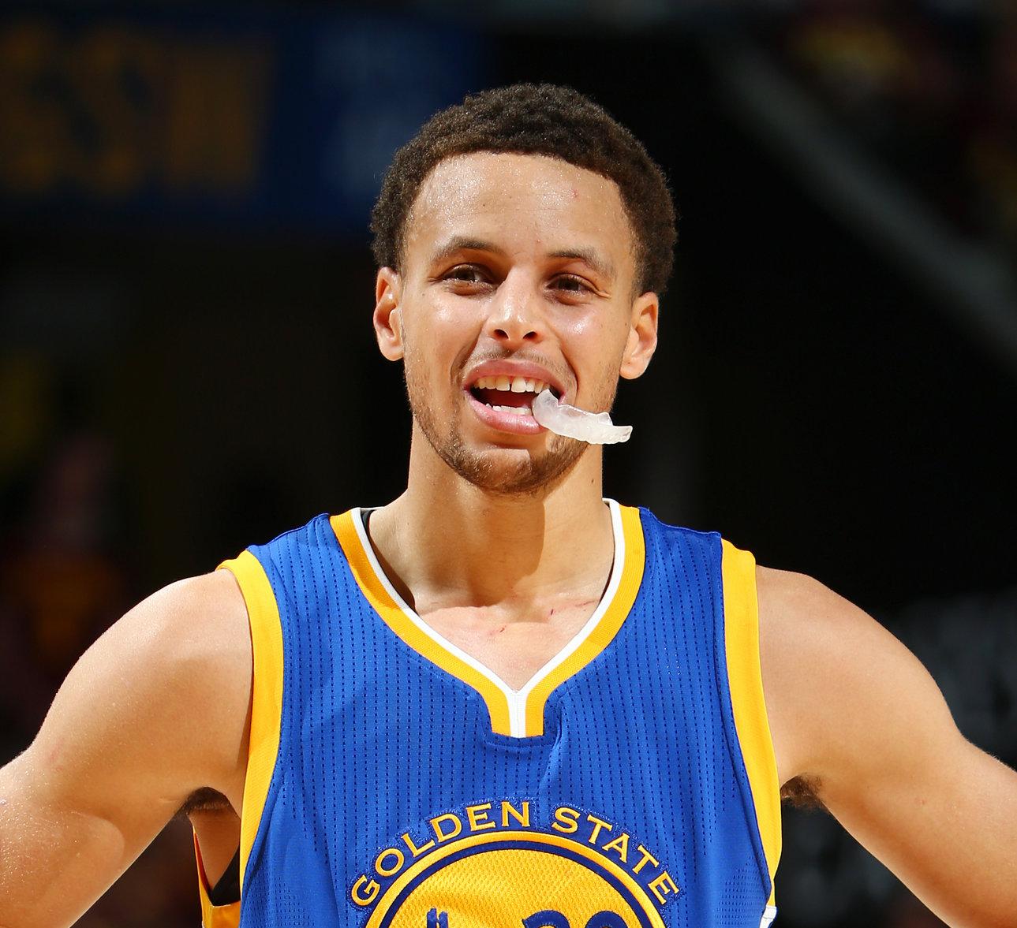
Putting the assumptions to work
Normative Q: Should we give Matt $100 or a Warriors ticket?
(1) $↔$ Matt is the best judge of his own well-being, so we should find out what Matt prefers.
NOT: “I think Warriors games are boring, so I’m going to give Matt $100.”
(2) $↔$ Matt does prefer one of these options to the other (or is indifferent).
NOT: Matt’s pref depends on whether it’s a full moon or new moon (arguably WARP violation!)
(3) $↔$ Can just look at choices to infer preferences!
This + (1) $→$we replace “what is best for Matt?” with “What would Matt choose?”
(Empirically, Matt revealed-prefers $100…)
Premises
We are all the best judges of our own well-being
Stable preferences
Choices mirror preferences
Notes:
Curry pic: https://www.nytimes.com/2015/06/16/magazine/stephen-currys-mouth-guard-an-investigation.html

Slide 12
The behavioral critique: sometimes choices are mistakes!
American visitors to the United Kingdom suffer numerous injuries and fatalities because they often look only to the left before stepping into streets even though they know traffic approaches from the right. One cannot reasonably attribute this to the pleasure of looking to the left or to masochistic preferences. The pedestrian’s objectives – to cross the street safely – are clear and the decision is plainly a mistake.
Bernheim and Rangel (2009)
Choices do not reveal preferences.
Optimal policy involves overriding an individual’s choice.
Notes:
Standard welfare econ would never reverse an individual’s choice in the absence of externalities!

Slide 13
The behavioral critique: sometimes choices are mistakes!
Standard premises (Bernheim and Taubinsky, 2018)
We are all the best judges of our own well-being
These judgements are governed by coherent, stable preferences
Our choices reflect our preferences: we choose the option we most prefer out of the available alternatives
How can these premises accommodate mistakes?
Revised (1): We are capable of being the best judges of our own well-being, when we are unbiased.
Revised (3): Our unbiased choices reflect our preferences.
If we can observe unbiased choices, then we can use all the tools of standard welfare economics.
Notes:
Can animate bullets. Possible pause to ask them how premises can accommodate mistakes
Possible to relax (2) but would require more math…

Slide 14
What is a bias or a mistake?
Getting hit by a car in London is obviously a mistake.
Can we write a general definition of a mistake/biased choice?
A common proposed definition
An unbiased choice is a choice that does reflect true preferences.
A biased choice is a choice that doesn’t reflect true preferences.
Problem: With this definition, we can’t use choice data to learn about true preferences.
Data on unbiased choices would reveal true preferences…
But the defn. uses true preferences to say which choices are unbiased
This is circular!
Need to identify mistakes in some other way…

Slide 15
Identifying Mistakes

Slide 16
Example 1: car purchases
On sunny days, people buy convertibles more than on rainy ones (Busse et al 2015)
Evidence of choice reversals (WARP violations).
Choice reversals: suggestive evidence of mistakes!
Why?
Matt is going to the car dealership on Saturday.
If it is sunny on Saturday, Matt will buy a convertible.
If it rains on Saturday, Matt will not buy a convertible.
It cannot be that both choices satisfy Matt’s true preferences!
Questions (discuss)
When are convertible purchases unbiased choices (i.e, when do choices reveal true preferences)?
How could you provide evidence to support your answer to 1?
Notes:
Pause for clar

Slide 17
Example 1: car purchases
When are convertible purchases unbiased choices?
At least three interpretations, with divergent policy implications
Choices when rainy rational, choices when sunny biased
Overconsumption of convertibles $→$ tax convertibles?
Choices when sunny rational, choices when rainy biased
Underconsumption of convertibles $→$ subsidize convertibles?
Choices are driven by projection bias
True utility is in between perceived utility on sunny days and perceived utility on rainy days. Some overconsumption, some underconsumption $→$ policy implication unclear
Providing evidence for a favored interpretation
Car returns after purchases on sunny days
Some choices on sunny days are mistakes. Rules out extreme version of (2).
But it’s harder to find evidence that non-purchases on rainy days are mistake
Experiment where treated consumers informed about frac. of rainy days?
Notes:
Could not decide whether to put “experiment: ask people to think about the true fraction of days when they’ll use convertibles and ask them to make choices again.” here or later

Slide 18
Example 2: Time-inconsistency
Matt has a reservation at Terun on Friday night
Matt will choose between eating pizza or salad
If Matt could pre-commit (decide Friday morning): salad
If Matt decides at Terun: pizza
Choice reversal (time-inconsistency)
Same discussion Qs:
Which choice is the mistake?
How could you provide evidence?
Notes:
Could not decide whether to put “experiment: ask people to think about the true fraction of days when they’ll use convertibles and ask them to make choices again.” here or later

Slide 19
Example 2: Time-inconsistency
Interpretation 1: Present bias.
Self-control problems cause present self to over-consume.
$→$ choice of salad unbiased, choice of pizza a mistake
Interpretation 2: Present focus need not be a bias.
Many argue that true happiness comes from living in the moment
Maybe people over-intellectualize when thinking about the future
$→$ choice of pizza unbiased, choice of salad a mistake!
Evidence
Economists often implicitly endorse (1), but rarely justify this interpretation
According to popular wisdom, no one wishes on their deathbed that they had put in more hours at the office. On the contrary, people tend to regret having worked too hard and spent too little time with their families. Thus, when economists advocate the long-run criterion as a general normative principle, one has to wonder whether this is simply a case of successful workaholics believing that everyone else ought to be more like them. – Bernheim (2016) on “Type-A paternalism”
In some cases, can invoke neuroscience
Evidence that addicts experience cue-triggered compulsions $→$ mistakes
E.g, an alcoholic attending a party where liquor is readily available

Slide 20
A systematic approach to identifying mistakes
General statement of the problem:
In situation A, agent chooses x over y.
In situation B, agent chooses y over x.
Which choice is unbiased?
Want a more robust criterion than “I think you are making a mistake in situation A.” (e.g, “I think you should smoke fewer cigarettes.”)
Seek evidence of characterization failures. Do people in A or B misunderstand some aspect of the choice problem?
Examples of characterization failures
Biased beliefs about outcomes or probabilities
Inattention to some aspect of decision
Imperfect memory: I forgot to consider something important
If no characterization failures, then choices reveal preferences!
Mistake = Choice reversal + Characterization failure
(Bernheim and Rangel 2009)
Notes:
Animate interpretations

Slide 21
Evidence of characterization failures: Allcott et al (2019)
Link survey measure of nutrition knowledge to soda consumption
Less knowledge about effect of sugary drinks on health $→$ more soda consumption
Controls for income, education, county, survey measures of taste for beverages/importance of health
Interpretation
Some soda consumption is driven by characterization failures
Unbiased choice = choice you’d make with full knowledge
“Normative consumer benchmark”
Table discussion: do you buy their interpretation? If so, why? If not, what could be more credible?
Notes:
The first of many Hunt Allcott papers…
It could be better to use the lightbulb here. I personally do NOT find this identification super credible.

Slide 22
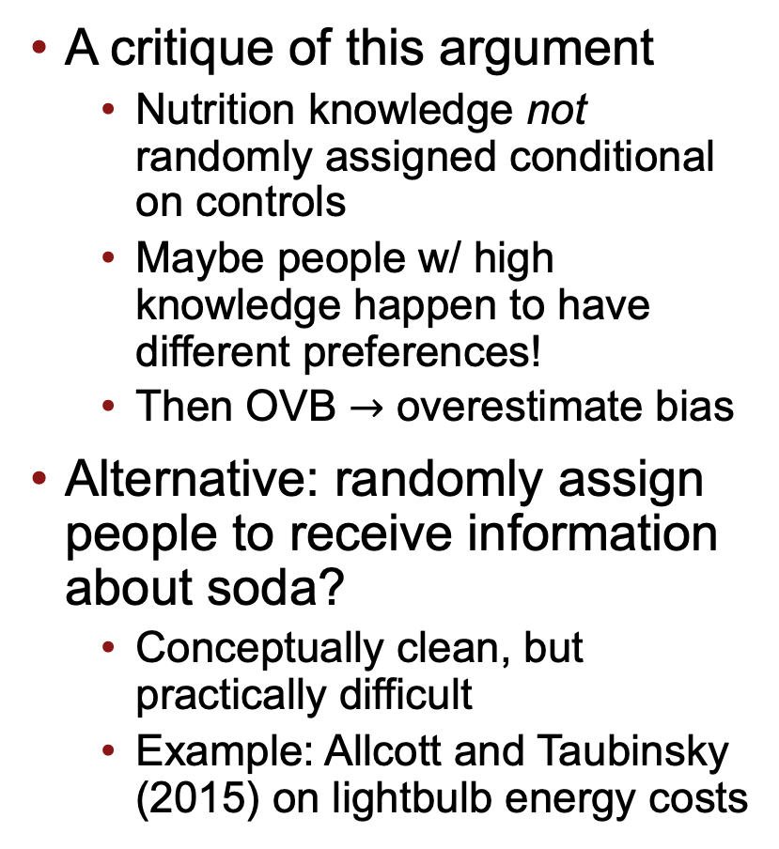
Providing evidence of characterization failures
A critique of this argument
Nutrition knowledge not randomly assigned conditional on controls
Maybe people w/ high knowledge happen to have different preferences!
Then OVB $→$ overestimate bias
Alternative: randomly assign people to receive information about soda?
Conceptually clean, but practically difficult
Example: Allcott and Taubinsky (2015) on lightbulb energy costs

Slide 23
Takeaways
Welfare economics: choices reveal preferences
Behavioral welfare economics: unbiased choices reveal prefs
Defining mistakes is normatively fraught
Mistake = Choice Reversal + Characterization Failure
Some ways to provide empirical evidence of mistakes
Information provision experiments
Normative consumer benchmark
Arguments from neuroscience
Notes:
We didn’t cover all the ways to provide evidence of mistakes. Dominated choices is another.

