Slide 1
Behavioral Economics And Public Policy: Extensions
Econ 178: Behavioral Economics
Marcelo Clerici-Arias

Slide 2
Logistics
Everyone should submit a unique concept map.
Fill out google form with time slot preferences.

Slide 3
Agenda
Let’s consider some extensions to yesterday’s model. Do they change our conclusions?
What if people are biased consumers of more than one good?
What if firms can eliminate mistakes?
What if interventions have unintended consequences?
Focus on modern research papers – this is what behavioral economists spend their time doing!

Slide 4
Allcott and Rafkin (2022): Substitution patterns and optimal policy

Slide 5
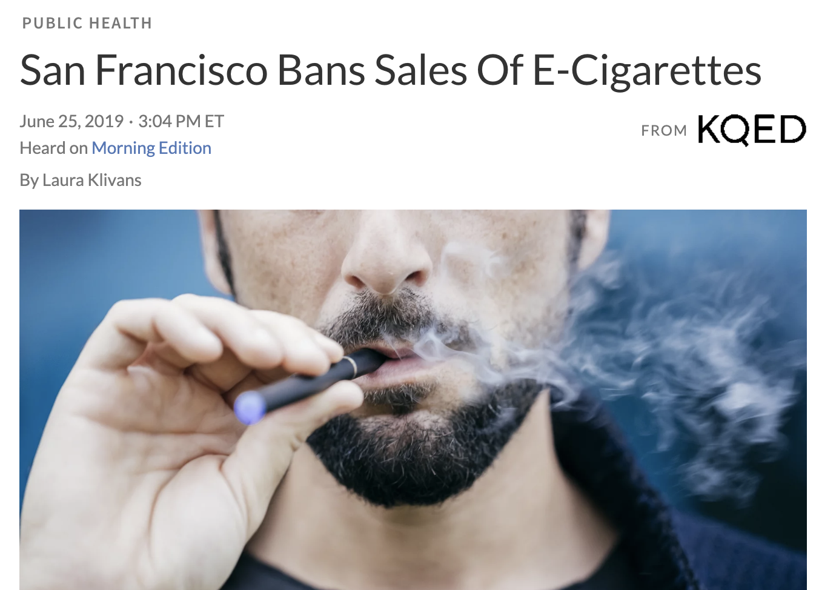
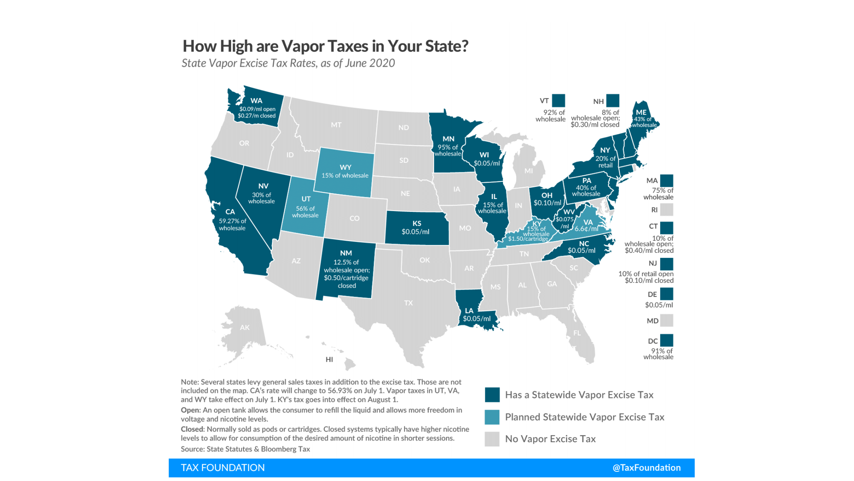
E-cigarette regulation
Health consequences of vaping controversial, possibly negative
“e-cigarette products contain and emit numerous potentially toxic substances” (National Academy of Sciences, 2018)… but experts express considerable uncertainty about long term health harms.
Concerns about addiction and health harms motivate policy
“This is a decisive step to help prevent another generation of San Francisco children from becoming addicted to nicotine.” SF City Attorney Dennis Herrerra
Notes:
NPR story source: https://www.npr.org/sections/health-shots/2019/06/25/735714009/san-francisco-poised-to-ban-sales-of-e-cigarettes
Vape Tax source: https://www.dropbox.com/s/sqg1nicxavxknat/Ecigs_Slides.pdf?dl=0 (Hunt’s slides)

Slide 6
When should we regulate e-cigarettes?
In our workhorse model, taxes and bans could be corrective policies to address biased overconsumption
Example: present bias $→$ underweight long term health costs $→$ overconsume
A key assumption of that model: single market for one good.
How might recommendations change if we allow e-cigarettes to be substitutes or complements for other goods?
Notes:
NPR story source: https://www.npr.org/sections/health-shots/2019/06/25/735714009/san-francisco-poised-to-ban-sales-of-e-cigarettes
Vape Tax source: https://www.dropbox.com/s/sqg1nicxavxknat/Ecigs_Slides.pdf?dl=0 (Hunt’s slides)

Slide 7
The importance of substitution patterns
Consider consumption patterns w.r.t. combustible cigarettes
Expert survey: e-cigs less harmful than cigs (Alcott and Rafkin 2022)
E-cigs and cigs could be substitutes
Example: You start vaping to quit smoking.
Then a tax or a ban on e-cigs would increase cig consumption
E-cigs and cigs could be complements
Example: Vaping is a “gateway” to combustible smoking
Then a tax or a ban on e-cigs would decrease cig consumption
If complementarity/substitution is empirically important, you should account for the effects of an e-cig tax on the cig market when you consider welfare effects!

Slide 8
If e-cigarettes and cigarettes are substitutes
Market for cigs
Market for e-cigs
$$t⋅\frac{dq^{cig}}{dp^{e−cig}}$$
Demand shift depends on elasticity of substitution
S1
S0
S
$$t$$
Price
Price
$$p_{0}$$
$$p_{1}$$
$$p_{1}$$
$$p_{0}$$
$$p_{1}+t$$
Mistaken (market) Demand
Normative Demand
D0
D1
$$q_{1}$$
$$q_{0}$$
Quantity
$$q_{0}$$
$$q_{1}$$
Quantity
Normative Demand 0
Normative Demand 1
Compare initial DWL to post-tax DWL
E-cig tax has two effects. 1) increases surplus in e-cig market, 2) decreases it in cig market
If (2) outweighs (1): a tax will backfire and an e-cig subsidy may be optimal!
Plausible if substitution is large and much more overconsumption of cigs than e-cigs
Notes:
va

Slide 9
Empirical evidence on substitution patterns
Previous slide assumed moderate substitution
If complements: conclusions go in the opposite direction!
Magnitude, not just sign, of substitution matters for overall welfare effects
So let’s look at some data!
Allcott and Rafkin (2022)
Nielsen scanner data: prices and quantities from 27K retail stores
Regress cigarette sales on e-cigarette prices
Instrument e-cigarette price with changes in the e-cigarette tax rate
Notes:
That paper also estimates a bunch of other parameters of course

Slide 10
Empirical evidence on substitution patterns
Insignificant complementarity, but standard errors are large (lots of uncertainty about estimate)
Notes:
This is online appendix table A3 (they also have a more complicated shift-share strategy that’s not worth going into)

Slide 11
What’s the optimal tax rate?
Paper calibrates a full model with more parameter estimates
Harms from smoking & vaping
Present bias ($β$ from QHD model)
Own-price elasticities
Externalities from smoking
Etc.
Substantial uncertainty about many key parameters
So they compute the optimal tax under many different assumptions
Table 4 of paper: 30 different estimates!
Also conduct Monte Carlo simulations of optimal tax to account for uncertainty across all parameter estimates
Notes:
This is online appendix table A3 (they also have a more complicated shift-share strategy that’s not worth going into)

Slide 12
Monte Carlo simulations
Average optimal tax estimate is $3.73/ml
This is positive because…
expert estimates of health harms from e-cigs are modest, but positive
substitution to cigs is negligible
But lots of uncertainty!
For 9% of simulations a subsidy is optimal
It could be that substitution is actually important!
And in some simulations the optimal tax is huge
This is because a few experts think e-cig health harms are very large
Notes:
Figure 01

Slide 13
Takeaways
Allcott and Rafkin (2022) is an example of the complementarity between mainstream and behavioral economics
It turns out we need to understand and estimate a cross-price elasticity to correctly implement a behaviorally-motivated policy
Example of the problem of the second-best
Approaches that are laser focused on correcting one bias without considering the bigger picture can backfire.
Another example: retirement savings (Bernheim and Taubinsky 2018)
Suppose (homogenous) people 1) overestimate the benefits of compound interest (causing over-saving) and 2) have present bias (causing under-saving).
Magnitude of (2) outweighs (1), so people under-save on average.
You have an educational policy intervention that corrects bias (1).
The policy will decrease savings, causing even more under-saving!
Substitution patterns are generally important for policy evaluation
This is an economic lesson, not just a behavioral economics lesson
Notes:
Section 2.6 of handbook

Slide 14
Gabaix and Laibson (2006): Inattention and Competition

Slide 15
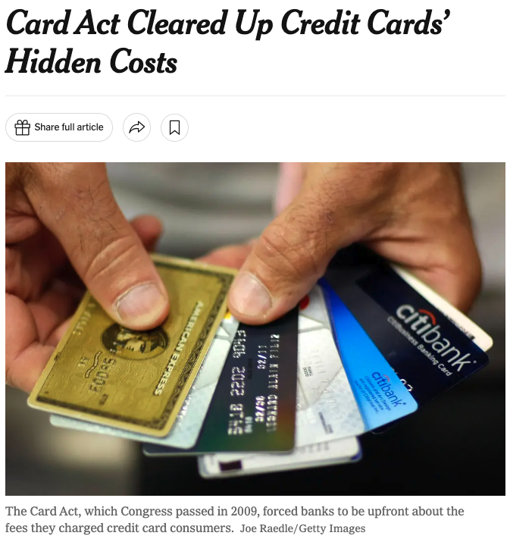
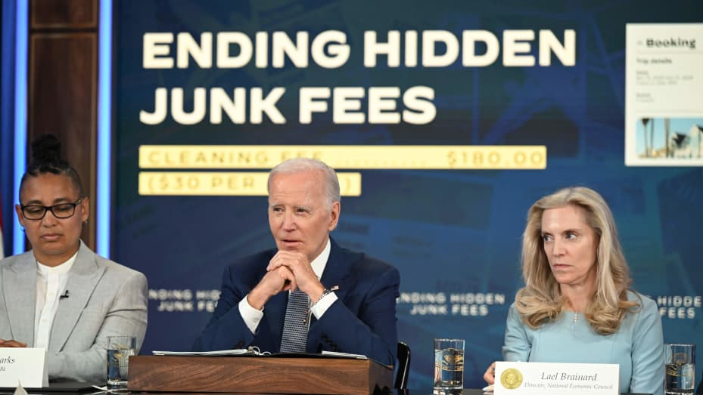
A particular type of bias: inattention to add-on fees
Credit cards, cell phones, rental cars, airlines
Goods with shrouded attributes
Old but vivid example: HP printers
Price of the printer plus first set of cartridges: $29.99
Price of each replacement set of cartridges: $29.99 (!)
Why? Only 3% of printer buyers check ink costs
Motivation for consumer protection policies
Notes:
Source 1: https://www.cnbc.com/2023/06/15/biden-pushes-ticketmaster-seatgeek-to-show-junk-fees-upfront.html
Source 2: https://www.nytimes.com/2013/11/08/business/economy/a-credit-card-rule-that-worked-for-consumers.html
Note here that nondisclosure is a little more puzzling that it might seem Gabaix and Laibson (2006): “At first glance, shrouding add-on prices seems like a natural marketing strategy. However, if consumers are all rational (or aware), shrouding could actually hurt the bank or printer manufacturer, because rational consumers will expect the worse from a firm that shrouds.” “Any information that is hidden in the fine print is not likely to be favorable to consumers. Rational consumers will infer that hidden prices are likely to be high prices.” This transitions nicely into the next slide.
Example: all the offers I get from Comcast/Xfinity with better services (add-ons) and prices, but with very fine print there are price increases in the future.

Slide 16
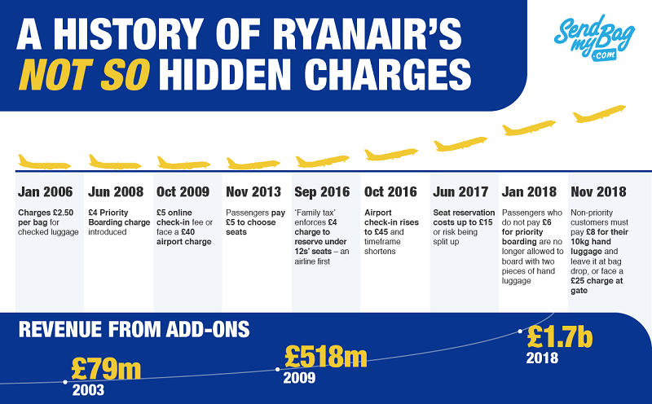
Notes:
Source: https://www.sendmybag.com/en-gb/blog/ryanair-history-of-add-on-charges/

Slide 17
Inattention and Competition
How does inattention affect market equilibrium?
A “market-pessimist” view
When consumers are inattentive, firms have incentives to shroud.
Undesirable market outcomes (overconsumption)
Better outcomes can be achieved through regulation (consumer protection)
A “market-optimist” view
If some firms shroud, others should be able to seize competitive advantage through practices that guarantee transparency.
Regulation is unnecessary and potentially counterproductive.
A perfect question for economic theory…

Slide 18
A model of budget airline prices
Simple version of Gabaix and Laibson (2006)
Airlines offer basic services and add-ons
Basic service: fare. Add-on: “airport registration fee”
Basic service costs $c$, add-on cost $0$ to firm
Consumers value basic service at $c$, add-on at $v$
Price of basic fare $q$, price of add-ons $p$
If plan ahead, consumers, can buy perfect substitutes for add-ons at cost $e$
E.g, hassle cost of doing registration in advance.
Fraction $α$ are naïve: cannot plan ahead. $1−α$ are sophisticated
For $e≤p≤v$: naïve consumers buy add-ons, sophisticates do not
Suppose $e≤p≤v$. What is the market price $q$?
Hint: assume free entry and exit of firms…
Notes:
PAUSE here for group work.

Slide 19
Market price with hidden fees
Notes:
Marcelo to derive here

Slide 20
Equilibrium with hidden fees
Basic fare with shrouded pricing: $q=c −αv$
Is this an equilibrium? $↔$ Can a firm steal customers by deviating/changing prices $p$ or $q$?
Cannot increase $q$ without changing $p$ (looks bad to all consumer types).
What if we cater to the sophisticates by charging $p<e$?
Remember, this was the market-optimist view! Firms should have incentives to provide transparency.
Most attractive version of this for sophisticates: marginal cost pricing
$p=0, q=c$
But compare surplus across cases
Shrouded pricing firm: Pay $c−αv+e$
Transparent pricing firm: Pay $c$
If $\frac{e}{α}<v$, the sophisticate will never choose the transparent firm!
Notes:
We didn’t make this condition clear in the last version of the slides.

Slide 21
What is going on here?
An obvious inefficiency
Everyone consumes the add-on.
Add-on costs $0$ for the firm to produce but $e$ for the consumer.
So it’s bad if the consumer is producing it
Ask TA Matt about frantically printing Ryanair boarding passes at 2:00 AM in Dublin…
Shrouding can survive competition. This is surprising!
Overturns a common market-optimist intuition.
Carl Shapiro (1995) on Kodak: A manufacturer could capture profits by raising its [base-good] prices above market levels (i.e., closer to cost), lowering its aftermarket prices below market levels (i.e., closer to cost), and informing buyers that its overall systems price is at or below market. In this fashion, the manufacturer could eliminate some or all of the deadweight loss, attract consumers by offering a lower total cost of ownership, and still capture as profits some of the eliminated deadweight loss. In other words, and unlike traditional monopoly power, the manufacturers have a direct incentive to eliminate even the small inefficiency caused by poor consumer information.
When and why doesn’t this argument go through?
Recall equilibrium condition: $\frac{e}{α}<v$
If many naïve people ($α$ high) base price $q$can be much lower at shrouding firms. Sophisticates want to take advantage of this cross-subsidy from naifs!
This is only worthwhile if substitution not too costly ($e$ low)
Notes:
Details on story: Ryanair charges a substantial (currently 55 euro) check-in fee if you do not have your boarding pass before you arrive at the airport. At the time (2018), Ryanair did not allow non-EU citizens to use mobile boarding passes. So to avoid the fee, you had to print your tickets. This was sometimes a big hassle cost. But worthwhile for me because one-way flights from Dublin to London are can be < $40 in base fare, even today.

Slide 22
The curse of debiasing
What about educational campaigns?
An example.
“Other airlines will surprise you by charging $v$for add-ons”
“We charge you only $p<v$for add-ons”
“The total cost of your flight will be lower if you choose us”
Would a transparent airline (TA) have an incentive to run this campaign?
Campaign turns some fraction of naifs into sophs.
People who stay soph: Don’t use TA, exploit cross-subsidies
People who stay naïve: Don’t use TA, can’t account for add-on costs
People who change from naïve to soph: Don’t use TA, exploit cross-subsidies – the campaign makes them plan ahead for the add-ons!
Generally unprofitable to make consumers sophisticated

Slide 23
Takeaways
The cycle of exploitation
Firms exploit naïve consumers with loss leader pricing and shrouded add-on fees
Sophisticated consumers exploit firms by planning ahead
No one wants to deviate except naifs, and they don’t know any better
Curse of debiasing: Firms have no incentive to educate consumers
This equilibrium is often bad
Inefficient because sophs engage in wasteful production (cost $e$ vs. $0$ of add-on)
Effect on equality is ambiguous. Constitutes a transfer from naifs to sophs.
Bad if naifs have higher MU
e.g, naifs are vulnerable and constantly exploited
Good if sophs have higher MU
e.g, the only people who are inattentive to add-on fees are rich people who can afford them
Regulations that break equilibrium can be beneficial (CARD act)
If you are personally a sophisticate… think about shopping at places with high add-on fees that you can avoid!
Notes:
Examples: hotels in vegas, if you don’t go to casino. Hotels with spas, if you don’t get a massage!

Slide 24
Hagmann, Ho, and Loewenstein (2019): The political economy of nudges

Slide 25
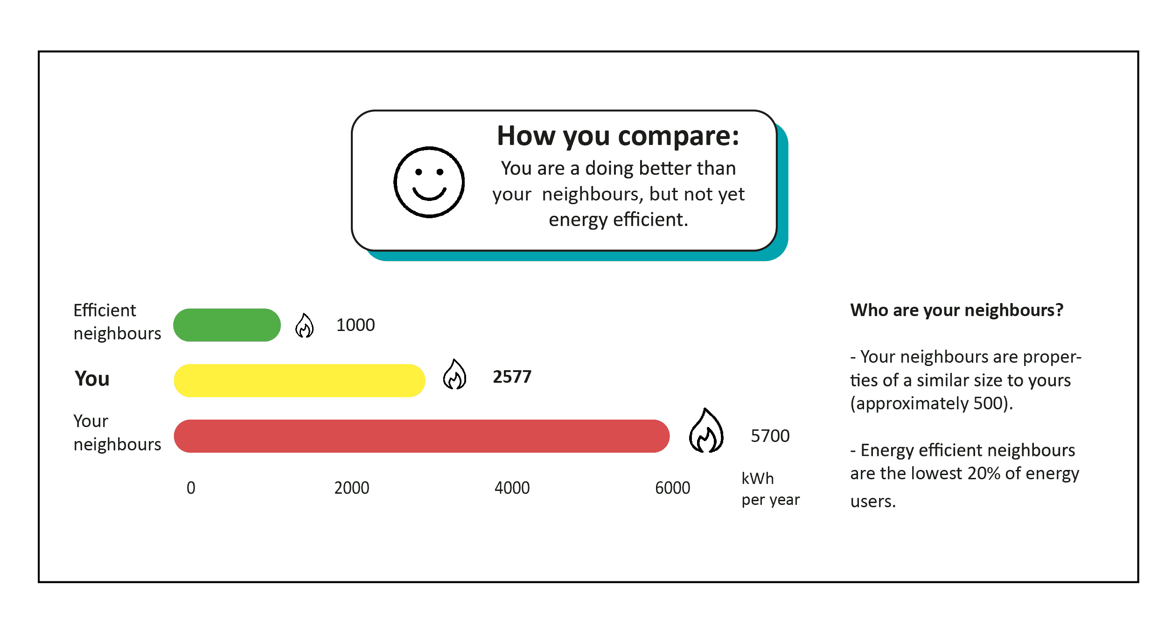
Climate Nudges
Notes:
Climate nudges: 1) just went to google flights
2) Little book of nudges https://www.bi.team/publications/the-little-book-of-green-nudges/
3) Shower head with disappearing polar bears (!!!) https://www.dw.com/en/incentives-for-a-greener-world-climate-friendly-decisions-behavioral-changes/a-62049794
4) Consumer energy report: https://thebehaviouralist.com/whats-a-green-nudge/

Slide 26
Climate Nudges
It has long been thought that to reduce environmental harm, the best approach is an economic incentive, perhaps a corrective tax. In recent years, however, increasing attention has been given to non-monetary interventions including ‘nudges’, such as information disclosure, warnings, uses of social norms, and default rules. A potentially promising intervention would automatically enroll people in green energy, subject to opt-out.
Cass Sunstein (2021)
Critique: non-monetary interventions typically have small effects (DellaVigna and Linos 2022), and optimal carbon tax is probably big.
Rejoinder: Nudges are still better than nothing!
Notes:
Sunstein (2021) is here https://pubmed.ncbi.nlm.nih.gov/33707660/
Got the quote from Loewenstein and Chater originally.
The DellaVigna and Linos paper is a meta analysis of 74 nudge treatments implemented by behavioral insights teams across many settings. Found median effect size of 1.4 p.p. with many null effects. I read that as a small effect.

Slide 27
History of the carbon footprint
BP popularized “carbon footprint”
Some claim that fossil fuel companies like climate nudges because they draw attention away from carbon tax proposals
Research Question
Does individual action “crowd out” support for systems-level interventions?
Notes:
BP Carbon footprint: https://www.bp.com/en_gb/target-neutral/home/calculate-and-offset-travel-emissions.html#/basket (accessed on Aug 29 2023)
Source (one of many) for claim that BP invented carbon footprint: https://www.theguardian.com/commentisfree/2021/aug/23/big-oil-coined-carbon-footprints-to-blame-us-for-their-greed-keep-them-on-the-hook
https://www.vox.com/22429551/climate-change-crisis-exxonmobil-harvard-study

Slide 28
Hagmann, Ho and Loewenstein (2022): Design
Choose the policies you would like to implement. “None of the above” is always an option.
Treatment 1:
A $40/ton carbon tax
Setting renewable energy plans as default options
Treatment 2:
A $40/ton carbon tax
Setting employer-sponsored retirement plans as default options
Treatments 3 & 4:
A $40/ton carbon tax
(Half of the subjects who received this question read about energy nudges first, the other half read about retirement savings nudges)
Notes:
reti

Slide 29
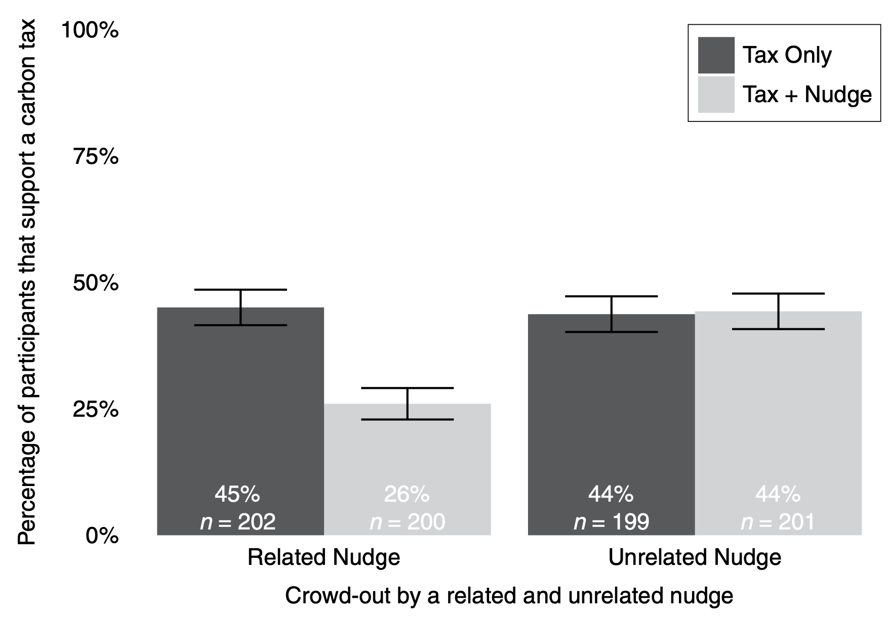
Hagmann, Ho and Loewenstein (2022): Results
Availability of green nudge cuts support for carbon tax by 40%
Not a mechanical effect of having another box to click: retirement savings nudge has no effect
Authors were disturbed by this finding!
Public relations specialists representing corporate interests have effectively deflected pressure for systemic change by reframing social problems in i-frame terms. They have learned to back i-frame interventions that pose little threat to the status quo while simultaneously lobbying heavily against proven s-frame changes that threaten their interests. The billions of dollars spent promoting i-frame interventions should make behavioral scientists uneasy. With the best of intentions, proponents of i-frame policy, including ourselves, may have inadvertently weakened support for crucial systemic changes. –- Chater and Loewenstein (2022)

Slide 30
Discussion
Chater and Loewenstein (2022): The i-frame and the s-frame
i-frame: attack policy problems by changing individual behavior
s-frame: attack policy problems with system-level interventions
Thesis: focus on i-frame reduces attention and support for s-frame changes
Another possible example: consumer finance
Some products arguably not designed in consumers’ best interest (e.g, actively managed funds with high fees)
Industry often supports financial education interventions, oppose regulations
Matt’s take
We should not ignore political economy of nudges. This paper is a stark reminder.
But there are still lots of open questions about how nudges affect attitudes!
Critics sometimes see nudges as part of a “slippery slope” to more intrusive interventions
E.g, Glaeser (2006) on cigarettes... Warnings on labels (i-frame) $→$ fewer people smoke $→$ greater support for taxation & regulation $→$ taxes and regulations (s-frame)
Implicit theory: sometimes nudges create support for s-frame interventions?
Good area for future research (undergrad thesis?)
Notes:
See “argument 6” of Glaeser for the cigarette discussion (https://chicagounbound.uchicago.edu/uclrev/vol73/iss1/8/)
Tell them to talk to Doug if they want to do a thesis on this stuff.

Slide 31
Conclusion

Slide 32
Final takeaways from this module
Our goal: understand when and how to implement behaviorally-motivated policies
Discussed normative assumptions
Mistake = Choice Reversal + Characterization Failure
Corrective taxation to address internalities
Optimal tax = price-metric bias
Which policy instrument should we choose?
Nudges are worse than taxes if they have negative direct effects
Nudges are no better than taxes if bias is homogenous
Nudges can improve upon taxes alone when they target heterogenous biases
And three extensions today
Substitution patterns matter for optimal policy
Competition doesn’t always create transparency
Nudges might have counterproductive political consequences

Slide 33
Final takeaways from this module
Nudges and other corrective policies are prominent
But the conversation around them often lacks structure
Go out into the world and help others think more clearly about behaviorally-motivated policy!

